Slide 1
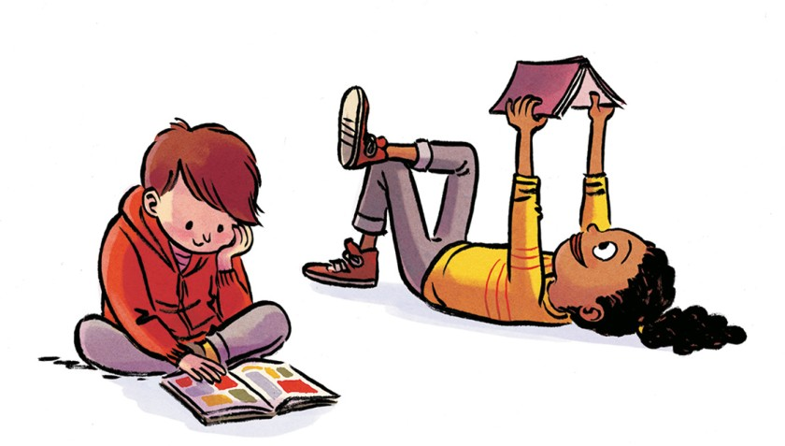
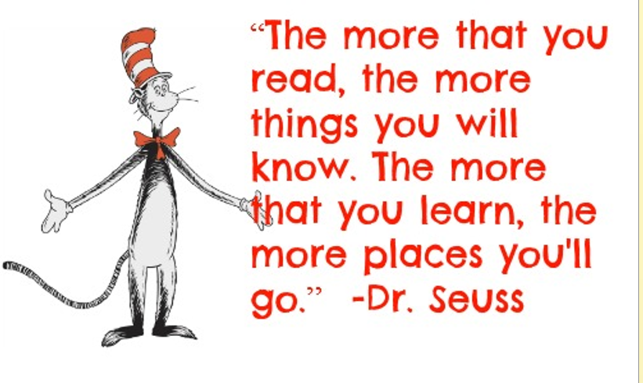
Reading Information Evening

Slide 2
Aims
To help you understand our Reading offer here at PRAPS.
To help you understand our how children learn to read and the skills they need.
To give you strategies when helping your child at home.
To underline the importance of children reading aloud to adults until they leave primary school (and after...)

Slide 3
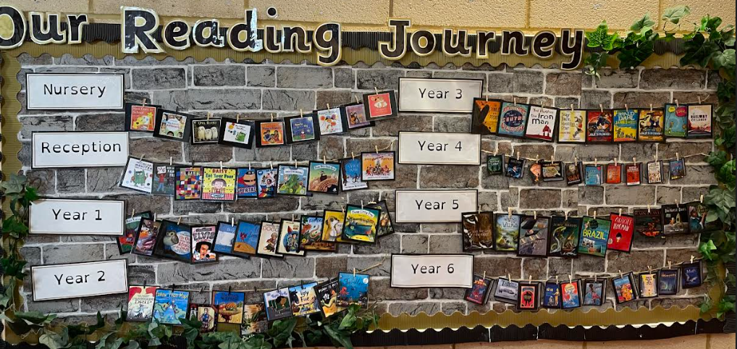
Why is reading so important
It helps children learn about the world in which they live.
Develops communication skills
Good writing starts with good reading.
It is a key skill needed to progress in all other subjects.
Children develop a love of reading.

Slide 4
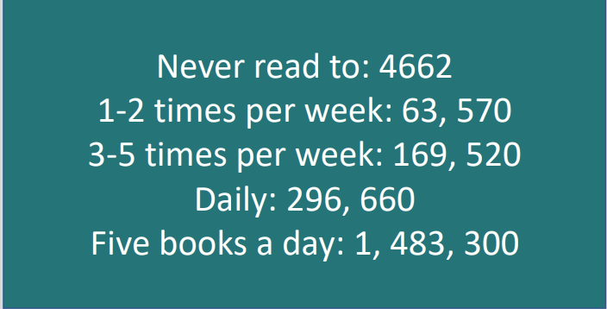
Reading supports vocabulary development

Slide 5


What skills do children need…
Decoding
Fluency
Vocabulary
Comprehension

Slide 6
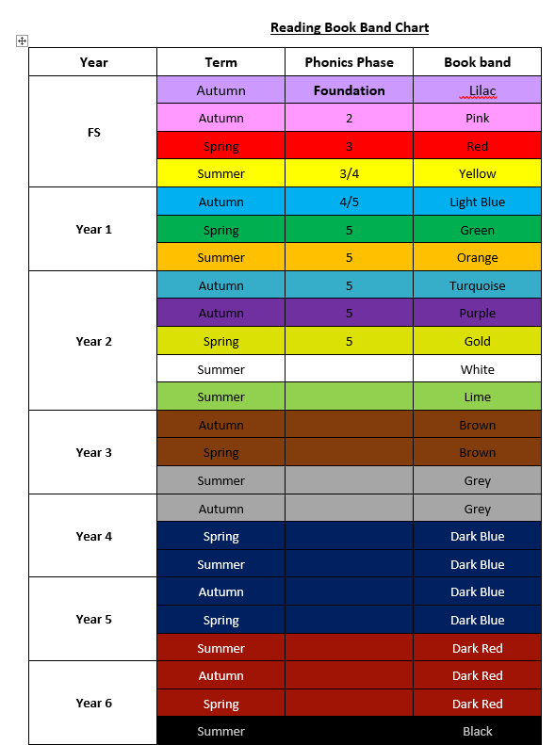
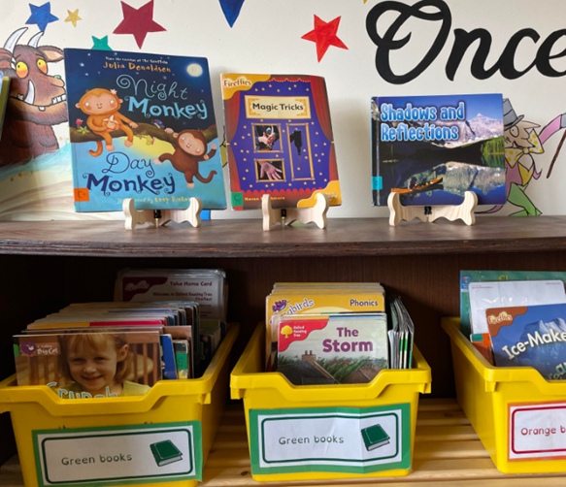
What do book bands mean?
At Park Road we use Book Bands as a consistent whole school approach to our reading books. The children are regularly assessed to ensure they are reading their book at the correct band with fluency, accurately and understanding.
The Book Band system is progressive, it helps us to grade our books by level of difficulty. Each level has its own colour and includes a selection of different reading scheme books and ‘real’ books.
The difference between each band is gradual, so that children will not experience difficulty when moving from one to the next.

Slide 7
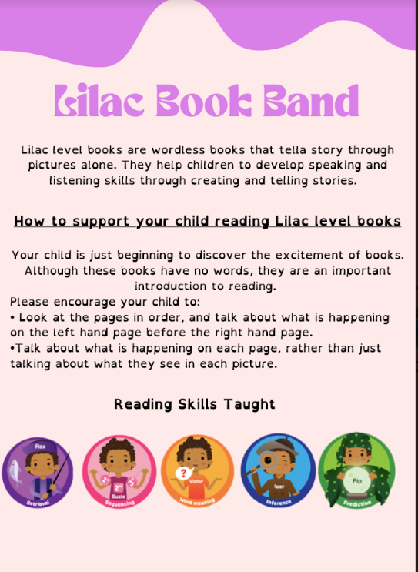

Slide 8
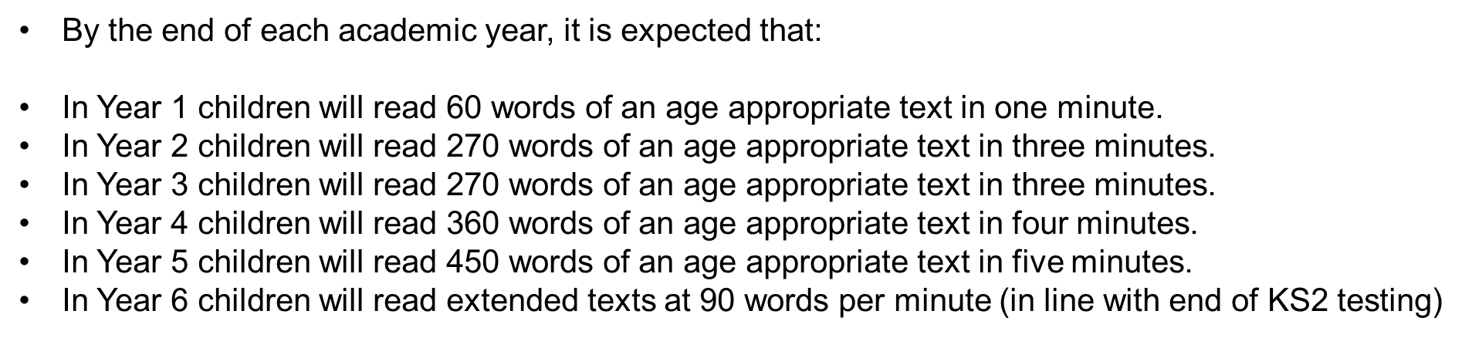
Reading fluency WPM

Slide 9
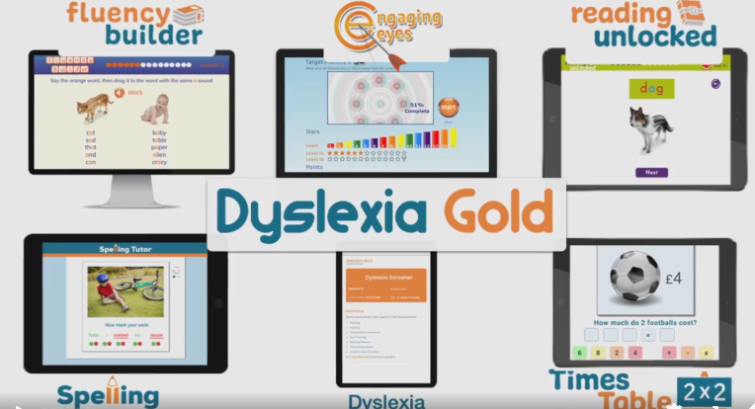

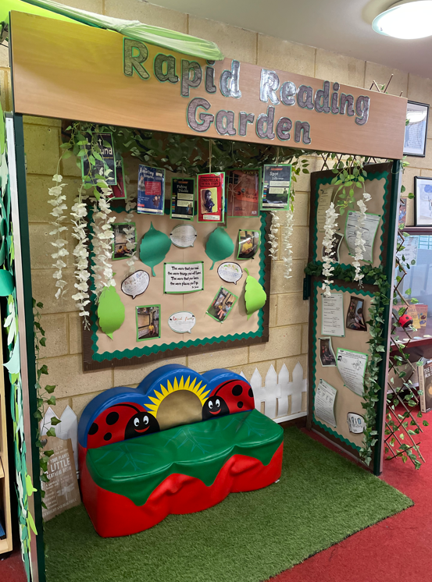

Support for children not making progress.
Individual catch
SEND SSP
Rapid Catch up 7+

Slide 10
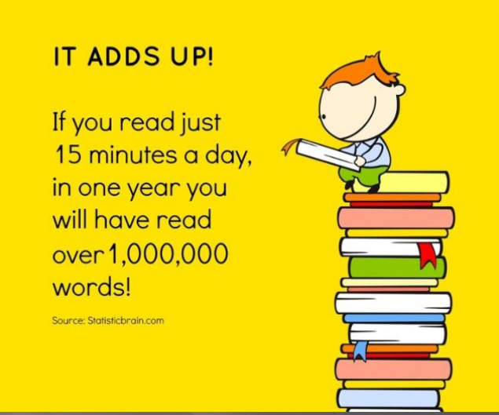
Importance of Reading at Home…
It has astonishing benefits for children: comfort and reassurance, confidence and security, relaxation, happiness and fun. Giving a child time and full attention when reading them a story tells them they matter. It builds self-esteem, vocabulary, feeds imagination and even improves their sleeping patterns

Slide 11
EYFS and KS1 Reading at home
Supporting your child with reading
Although your child will be taught to read at school, you can have a huge impact on their reading journey by continuing their practice at home.
There are two types of reading book that your child may bring home:
A reading practice book. This will be at the correct phonic stage for your child. They should be able to read this fluently and independently. You will be given a Colins ebook login to access this.
A sharing book. Your child will not be able to read this on their own. This book is for you both to read and enjoy together.
<iframe title="vimeo-player" src="https://player.vimeo.com/video/743027301?h=b26e4816a8" width="640" height="360" frameborder="0" allowfullscreen></iframe>

Slide 12
Sharing book
In order to encourage your child to become a lifelong reader, it is important that they learn to read for pleasure. The sharing book is a book they have chosen for you to enjoy together.
Please remember that you shouldn’t expect your child to read this alone. Read it to or with them. Discuss the pictures, enjoy the story, predict what might happen next, use different voices for the characters, explore the facts in a non-fiction book. The main thing is that you have fun!

Slide 13
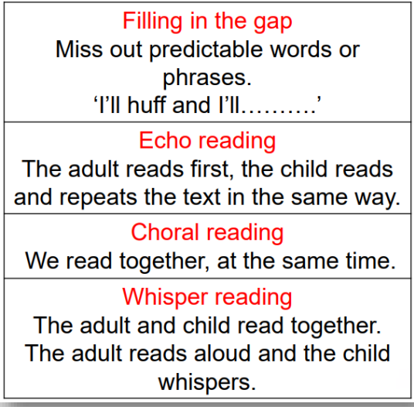

Slide 14

Reading practice book – reading book
This book has been banded, carefully matched to your child’s current reading level. If your child is reading it with little help, please don’t worry that it’s too easy – your child needs to develop fluency and confidence in reading.
The children are regularly assessed to ensure they are reading their book at the correct band with fluency, accurately and understanding. The Book Band system is progressive, it helps us to grade our books by level of difficulty. Each level has its own colour and includes a selection of different reading scheme books and ‘real’ books.
Listen to them read the book. Remember to give them lots of praise – celebrate their success! If they can’t read a word, read it to them. After they have finished, talk about the book together.

Slide 15
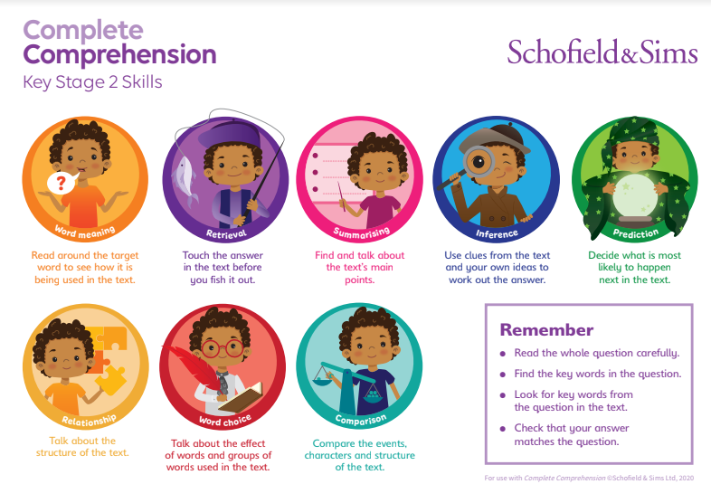
KS2 Reading at home
Book Bands – reading book

Slide 16
It is really important that children develop their comprehension skills alongside their ability to read the words on the page, so you may find that your child is able to read the words fluently, but continues on the same Book Band colour for a while to enable them to focus on developing their understanding. Class teachers listen to the children’s reading on a regular basis and will change their Book Band colour only when they are confident that both the comprehension and word reading targets have been fully met.
There will be a wide of reading abilities in any year group or class. As a rough guide, children should be able to read at least 90% of the words on the page without any problem.
You will be doing your child no favours if you rush them through books. It is not a race, it is a journey! Children learn at different rates just as they learn to walk, dress themselves etc. at different rates. Reading must not be treated as a competition. If children are rushed through the books they will not achieve the enjoyment and understanding necessary. Books that they find too difficult will put them off reading!

Slide 17

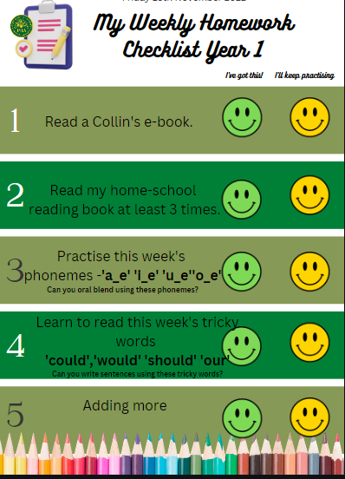
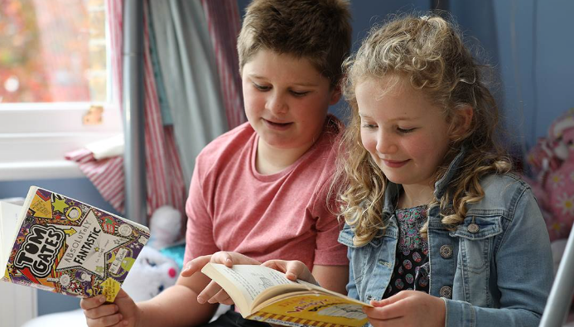
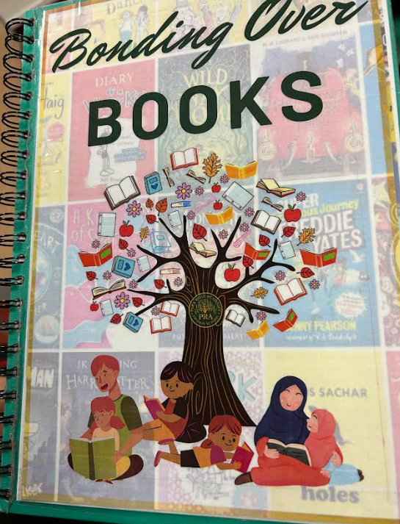
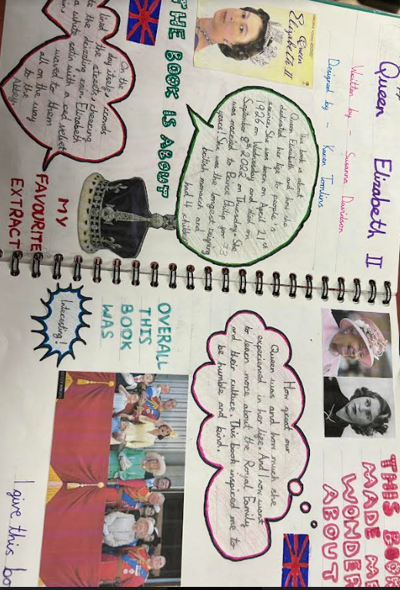
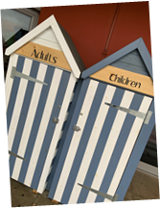
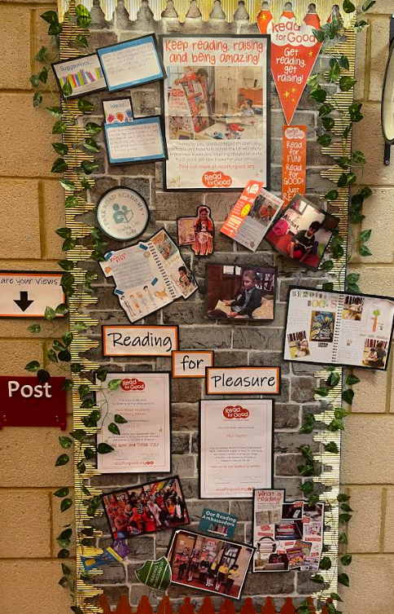


Our reading offer
Reading book
Home work

Slide 18
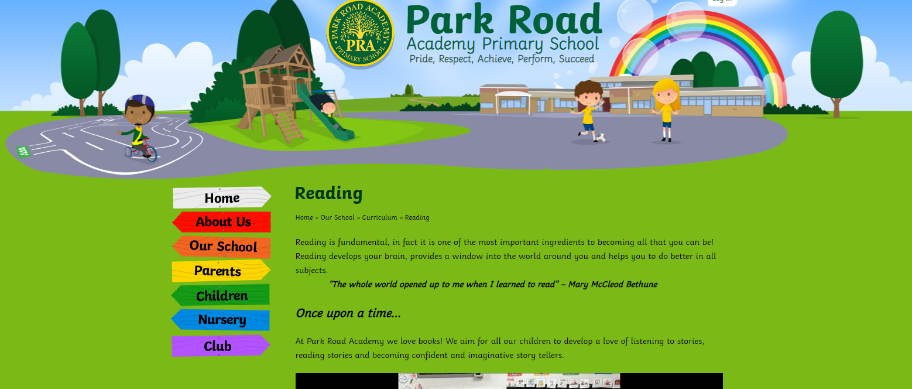
Check out!

Slide 19
Thanks for coming, please feel free to have a look at our Reading resources.

